Slide 1
Introduction
Lecture slides for Chapter 1 of Deep Learning
www.deeplearningbook.org
Ian Goodfellow
Adapted by: m.n. for CMPS 392

Slide 2
Introduction
Inventors have long dreamed of creating machines that think
Today, artiﬁcial intelligence(AI) is a thriving ﬁeld with many practical applications and active research topics.
The field rapidly tackled and solved problems that are intellectually difficult for human beings but relatively straightforward for computers
Mathematical rules
The true challenge to artificial intelligence proved to be solving the tasks that are easy for people to perform but hard for people to describe formally
Recognizing spoken words or faces in images.

Slide 3
Deep learning
Learn from experience
understand the world in terms of a hierarchy of concepts
each concept defined in terms of its relation to simpler concepts.
If we draw a graph showing how these concepts are built on top of each other, the graph is deep, with many layers.
For this reason, we call this approach to AI deep learning.

Slide 4
Computer vs. Human
IBM’s Deep Blue chess-playing system defeated world champion Garry Kasparov in 1997
Chess is of course a very simple world!
A person’s everyday life requires an immense amount of knowledge about the world.
Much of this knowledge is subjective and intuitive, and therefore difficult to articulate in a formal way.
Computers need to capture this same knowledge in order to behave in an intelligent way.

Slide 5
Previous AI appraches
Knowledge base: A computer can reason about statements in a formal language automatically using logical inference rules.
Cyc failed to understand a story about a person named Fred shaving in the morning
people do not have electrical parts,
but Fred was holding an electric razor
“FredWhileShaving” contained electrical parts.
Cyc asked whether Fred was still a person while he was shaving!

Slide 6
Machine learning
Extracting patterns from raw data.
A simple machine learning algorithm called logistic regression can determine whether to recommend cesarean delivery
A simple machine learning algorithm called naive Bayes can separate legitimate e-mail from spam e-mail.
The performance of these simple machine learning algorithms depends heavily on the representation of the data they are given.

Slide 7
Features
Each piece of information included in the representation of the patient is known as a feature.
Logistic regression learns how each of these features of the patient correlates with various outcomes
the choice of representation has an enormous effect on the performance of machine learning algorithms

Slide 8
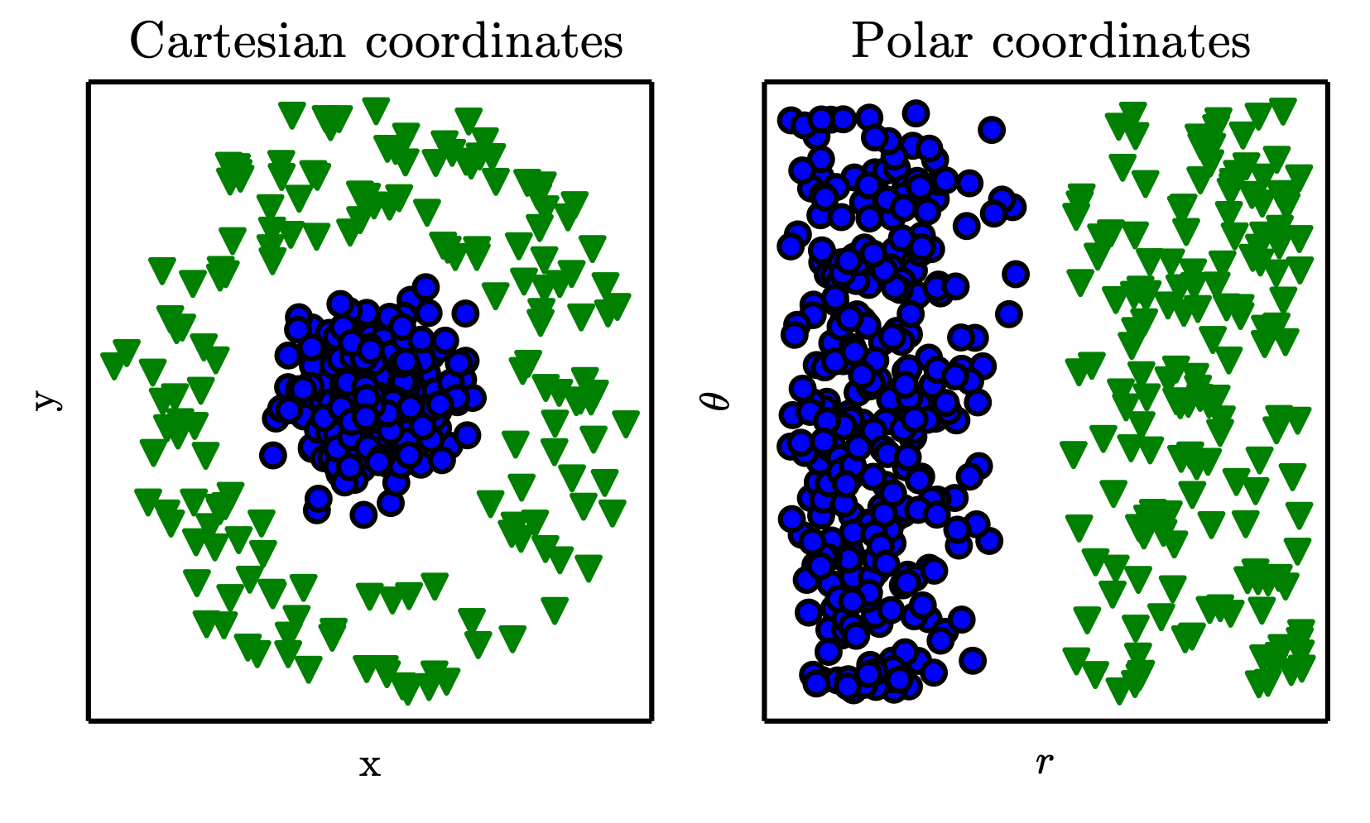
Representations Matter
Figure 1.1

Slide 9
Representation Learning
However, for many tasks, it is difficult to know what features should be extracted.
For example, suppose that we would like to write a program to detect cars in photographs.
We know that cars have wheels,
But how to describe exactly what a wheel looks like in terms of pixel values?
We need to discover not only the mapping from representation to output
but also the representation itself.

Slide 10
Autoencoders
An autoencoder is the combination of an encoder function that converts the input data into a different representation,
and a decoder function that converts the new representation back into the original format.
Autoencoders are trained to preserve as much information
but are also trained to make the new representation have various nice properties.

Slide 11
Factors of variation
When analyzing an image of a car, the factors of variation include the position of the car, its color, and the angle and brightness of the sun.
When analyzing a speech recording, the factors of variation include the speaker’s age, their sex, their accent and the words that they are speaking
How to disentangle the factors of variation and discard the ones that we do not care about?

Slide 12
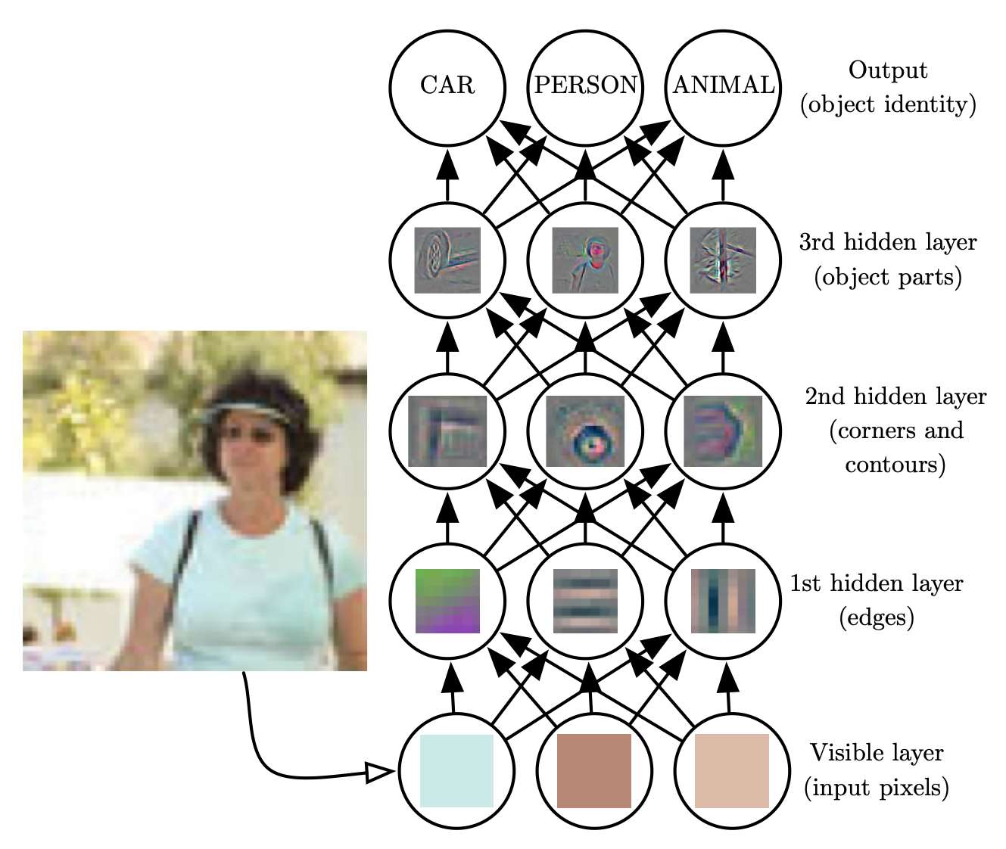
Depth: Repeated Composition
Figure 1.2

Slide 13
Multilayer perceptron (MLP)
A multilayer perceptron is just a mathematical function mapping some set of input values to output values.
The function is formed by composing many simpler functions.
We can think of each application of a different mathematical function as providing a new representation of the input.

Slide 14
Multi-step computer program
Another perspective is that depth allows the computer to learn a multi-step computer program.
Each layer of the representation can be thought of as the state of the computer’s memory after executing another set of instructions in parallel
Networks with greater depth can execute more instructions in sequence.
Sequential instructions offer great power because later instructions can refer back to the results of earlier instructions.
Notes:
This state information could be analogous to a counter or pointer in a traditional
computer program. It has nothing to do with the content of the input specifically,
but it helps the model to organize its processing.

Slide 15
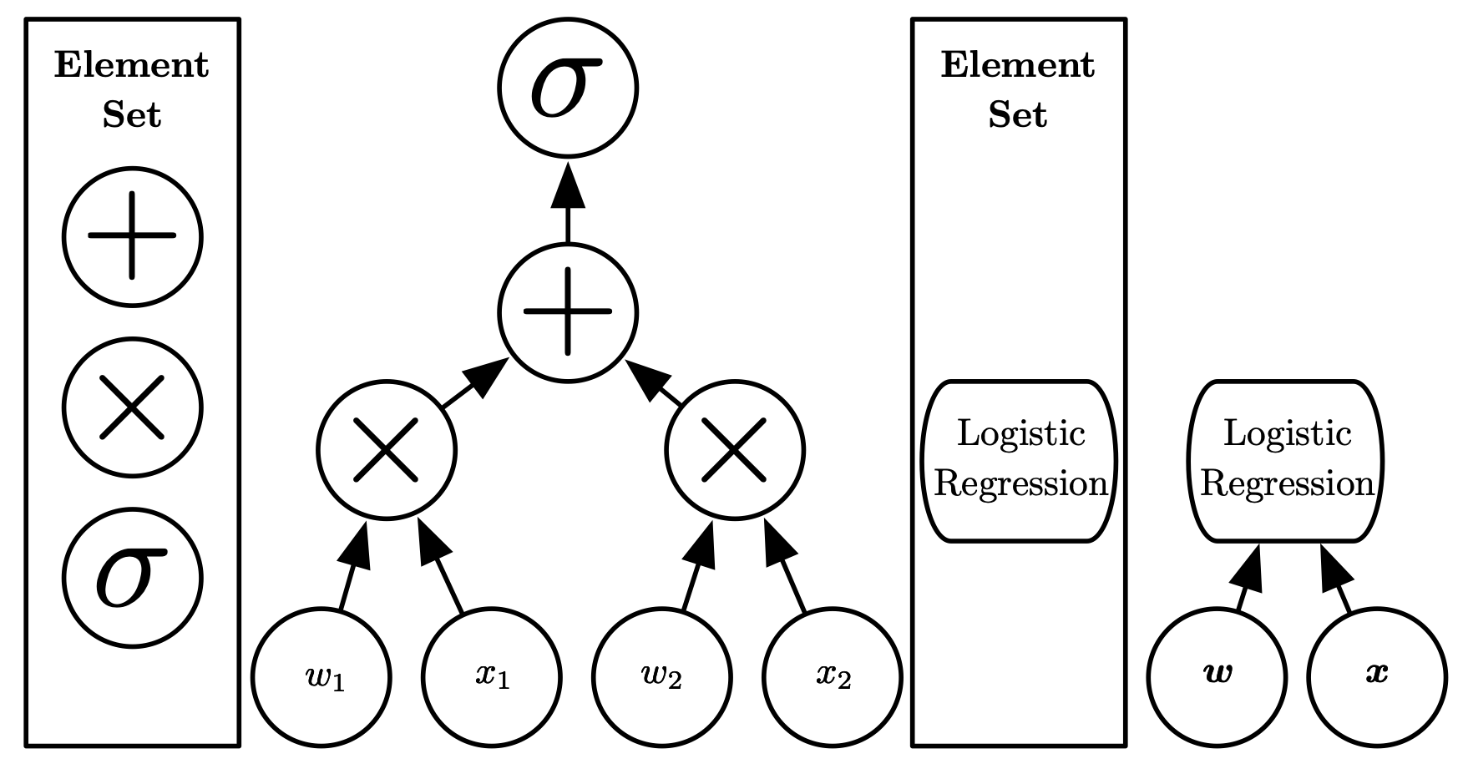
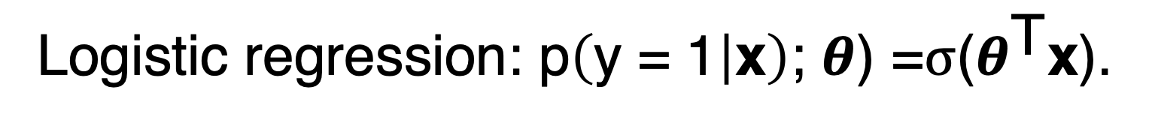
Computational Graphs
Logistic regression: $\text{p}\left(\text{y}\text{ = 1} | \text{x}\right)\text{; }θ\text{) =}σ\text{(}θ^{\text{T}}\text{x}\text{).}$
Figure 1.3

Slide 16
Notion of depth
Depth is the length of the longest path from input to output but depends on the definition of what constitutes a possible computational step.
If we use addition, multiplication and logistic sigmoids as the elements of our computer language, then this model has depth three.
If we view logistic regression as an element itself, then this model has depth one.

Slide 17
Deep learning vs. machine learning
Deep learning is:
An approach to AI
A type of machine learning
a technique that allows computer systems to improve with experience and data
can safely be regarded as the study of models that either involve a greater amount of composition of learned functions or learned concepts than traditional machine learning does.

Slide 18
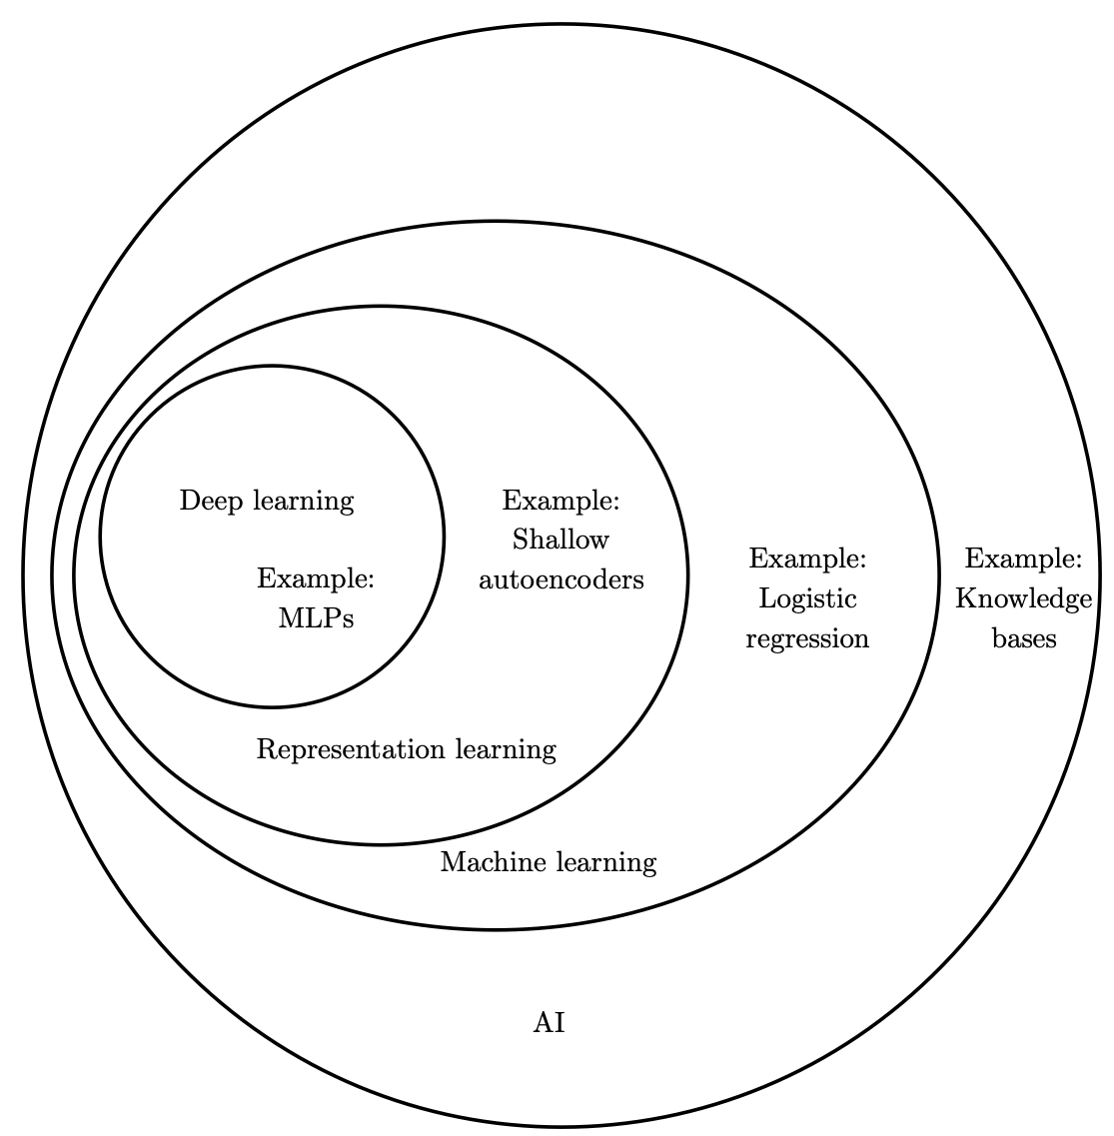
Machine Learning and AI
Machine learning can operate in complicated, real-world environments
Deep learning is a particular kind of machine learning that achieves great power and flexibility
Figure 1.4
Notes:
Deep learning is a particular kind of machine learning that achieves great power and flexibility
by learning to represent the world as a nested hierarchy of concepts, with each concept defined in relation to simpler concepts, and more abstract representations computed in terms of less abstract ones.

Slide 19
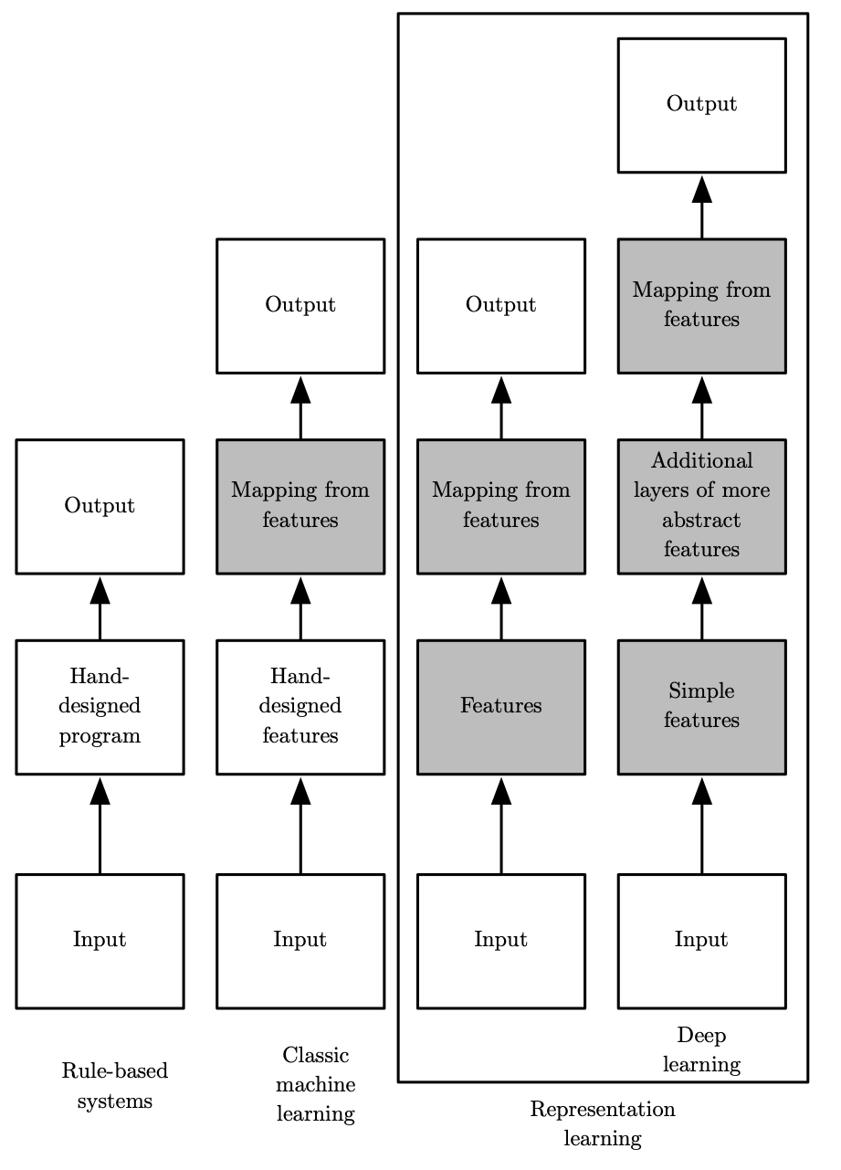
Learning Multiple Components
Figure 1.5

Slide 20
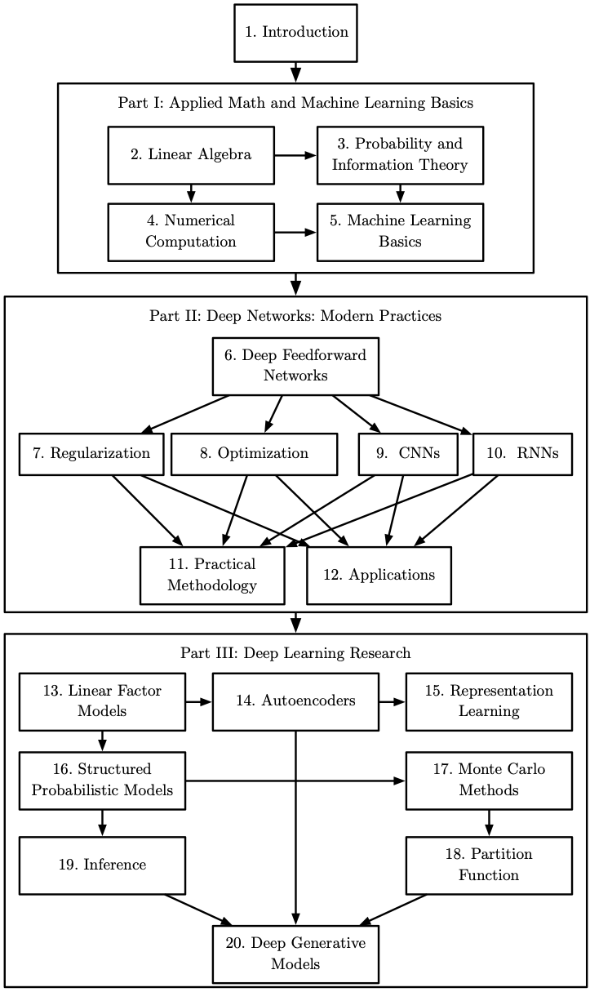
Organization of the Book
Figure 1.6

Slide 21
Who should take this course?
University students (undergraduate or graduate)
If you want to begin a career in deep learning and artificial intelligence research
If you want to work as software engineer and want to rapidly acquire machine learning background and begin using deep learning in your product or platform.
Applications:
computer vision, speech and audio processing, natural language processing, robotics, bioinformatics and chemistry, video games, search engines, online advertising and finance.

Slide 22
Prerequisities
We do assume that all readers come from a computer science background.
We assume familiarity with
programming,
a basic understanding of computational performance issues, complexity theory,
introductory level calculus
and some of the terminology of graph theory.

Slide 23
Deep learning history
DL has had a long and rich history, but has gone by many names reflecting different philosophical viewpoints, and has waxed and waned in popularity.
DL has become more useful as the amount of available training data has increased.
DL models have grown in size over time as computer infrastructure (both hardware and software).
DL has solved increasingly complicated applications with increasing accuracy over time.

Slide 24
History
Three waves of development of deep learning:
Cybernetics in the 1940s–1960s
Connectionism in the 1980s–1990s
Deep learning starting 2006
Artificial neural networks (ANNs): engineered systems inspired by the biological brain
the brain provides a proof by example that intelligent behavior is possible
ANNs can help understanding the brain and the principles that underlie human intelligence
Current deep learning frameworks are not necessarily neurally inspired
Notes:
Cybernetics : the science of communications and automatic control systems in both machines and living things.

Slide 25
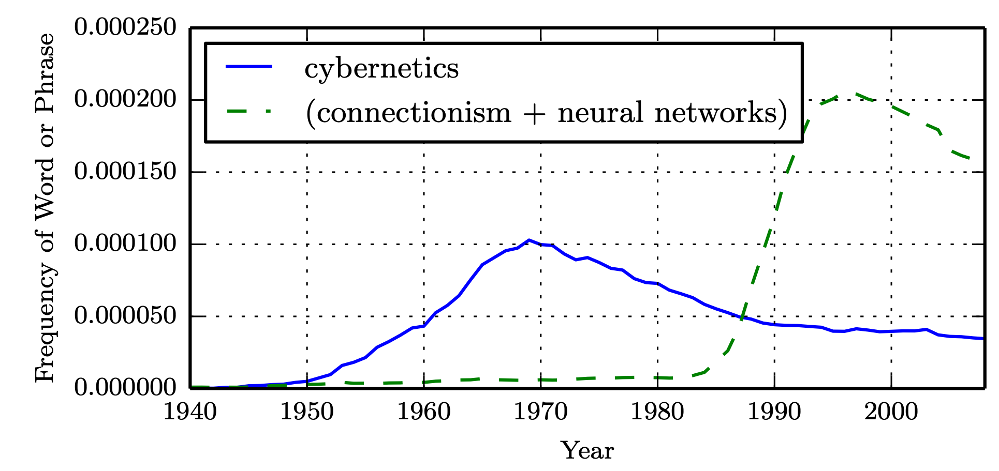
Historical Waves
Figure 1.7

Slide 26
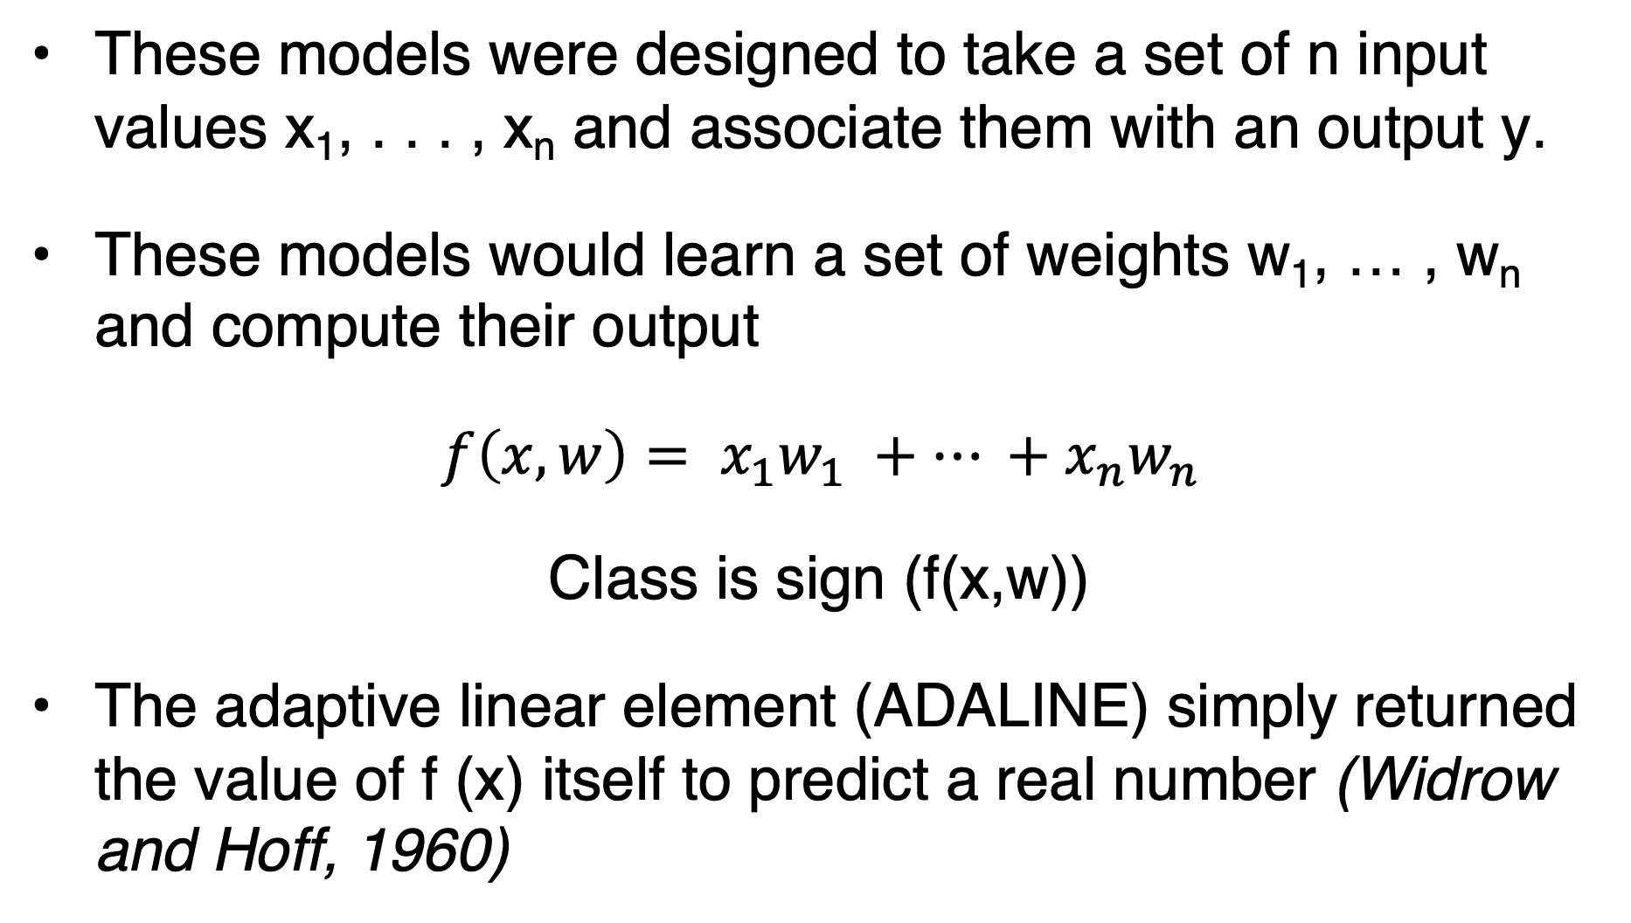
Perceptron (Rosenblatt, 1958, 1962)
These models were designed to take a set of n input values x₁, . . . , x_{n} and associate them with an output y.
These models would learn a set of weights w₁, … , w_{n} and compute their output
$f\left(x,w\right)= x_{1}w_{1} +… +x_{n}w_{n}$
Class is sign (f(x,w))
The adaptive linear element (ADALINE) simply returned the value of f (x) itself to predict a real number (Widrow and Hoff, 1960)

Slide 27
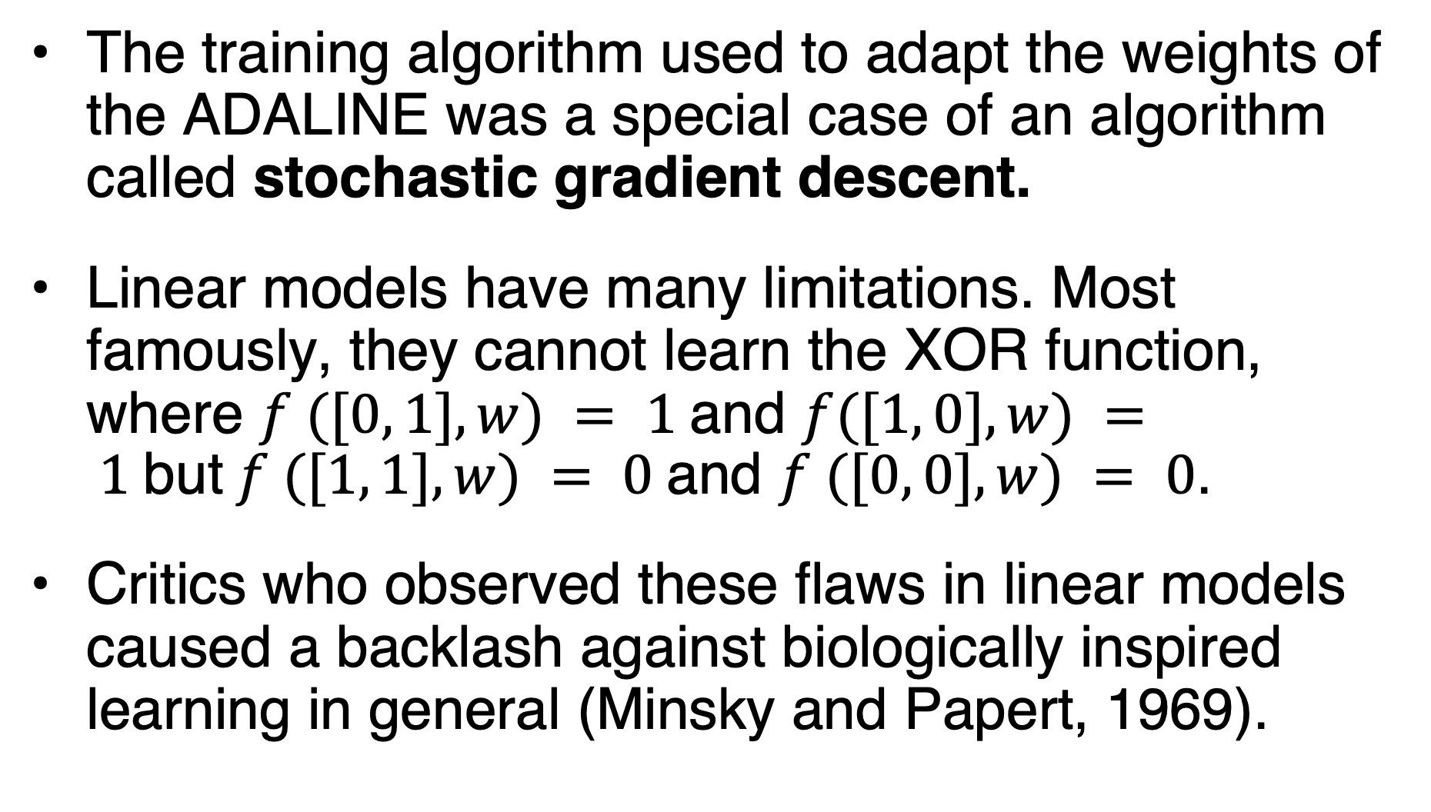
Linear models (e.g. Perceptron, Adaline)
The training algorithm used to adapt the weights of the ADALINE was a special case of an algorithm called stochastic gradient descent.
Linear models have many limitations. Most famously, they cannot learn the XOR function, where $f ([0, 1], w) = 1$and $f([1, 0], w) = 1$but$f ([1, 1], w) = 0$and $f ([0, 0], w) = 0$.
Critics who observed these flaws in linear models caused a backlash against biologically inspired learning in general (Minsky and Papert, 1969).

Slide 28
Neuroscience
Neuroscience has given us a reason to hope that a single deep learning algorithm can solve many different tasks.
Neuroscientists have found that ferrets can learn to “see” with the auditory processing region of their brain if their brains are rewired to send visual signals to that area (Von Melchner et al., 2000).
Today, we simply do not have enough information about the brain to use it as a guide.

Slide 29
Connectionism
Distributed representation (Hinton et al., 1986)
Each input to a system should be represented by many features,
and each feature should be involved in the representation of many possible inputs.
Example: shape vs. color
Backpropagation: (Rumelhart et al., 1986; LeCun, 1987).
currently the dominant approach to training deep models.
Notes:
For example, suppose we have a vision system that can recognize
cars, trucks, and birds and these objects can each be red, green, or blue. One way
of representing these inputs would be to have a separate neuron or hidden unit
that activates for each of the nine possible combinations: red truck, red car, red
bird, green truck, and so on. This requires nine different neurons, and each neuron
must independently learn the concept of color and object identity. One way to
improve on this situation is to use a distributed representation, with three neurons
describing the color and three neurons describing the object identity. This requires
only six neurons total instead of nine, and the neuron describing redness is able to
learn about redness from images of cars, trucks and birds, not only from images
of one specific category of objects.

Slide 30
Second winter
Ambitious claims while seeking investments.
other fields of machine learning made advances. Kernel machines (Boser et al., 1992; Cortes and Vapnik, 1995; Schölkopf et al., 1999) and graphical models (Jordan, 1998)
These two factors led to a decline in the popularity of neural networks that lasted until 2006-2007.

Slide 31
Third wave
Researchers showed that they were able to train deeper neural networks than had been possible before, and focused attention on the theoretical importance of depth
We have the computational resources to run much larger models today.
As of 2016, a rough rule of thumb is that a supervised deep learning algorithm will generally achieve acceptable performance with around 5,000 labeled examples per category, and will match or exceed human performance when trained with a dataset containing at least 10 million labeled examples.

Slide 32
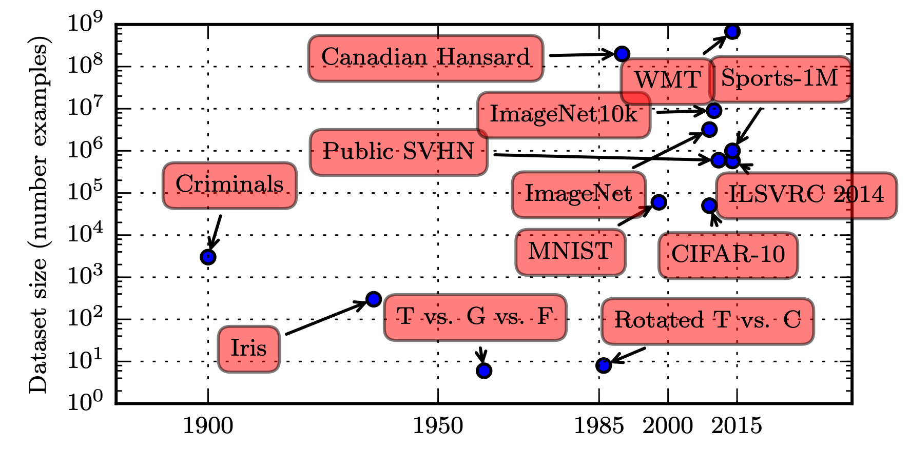
Historical Trends: Growing Datasets
Figure 1.8

Slide 33
Historical Trends: Increasing model sizes
faster CPUs,
the advent of general purpose GPUs,
faster network connectivity,
better software infrastructure for distributed computing.

Slide 34
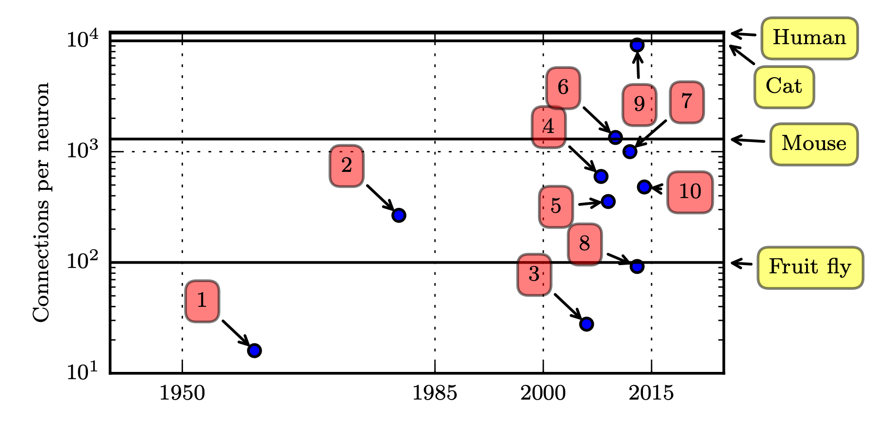
Connections per Neuron
Figure 1.10
Notes:
1. Adaptive linear element (Widrow and Hoff, 1960)
2. Neocognitron (Fukushima, 1980)
3. GPU-accelerated convolutional network (Chellapilla et al., 2006)
4. Deep Boltzmann machine (Salakhutdinov and Hinton, 2009a)
5. Unsupervised convolutional network (Jarrett et al., 2009)
6. GPU-accelerated multilayer perceptron (Ciresan et al., 2010)
7. Distributed autoencoder (Le et al., 2012)
8. Multi-GPU convolutional network (Krizhevsky et al., 2012)
9. COTS HPC unsupervised convolutional network (Coates et al., 2013)
10. GoogLeNet (Szegedy et al., 2014a)

Slide 35
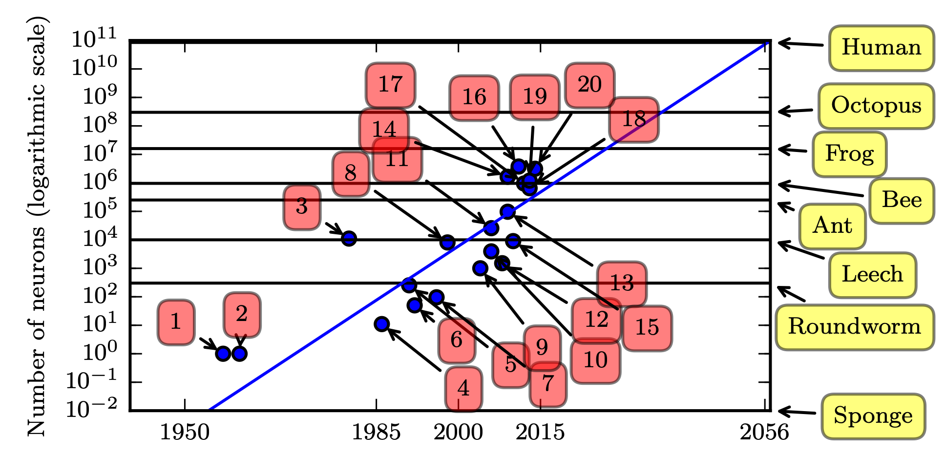
Number of Neurons
Figure 1.11

Slide 36
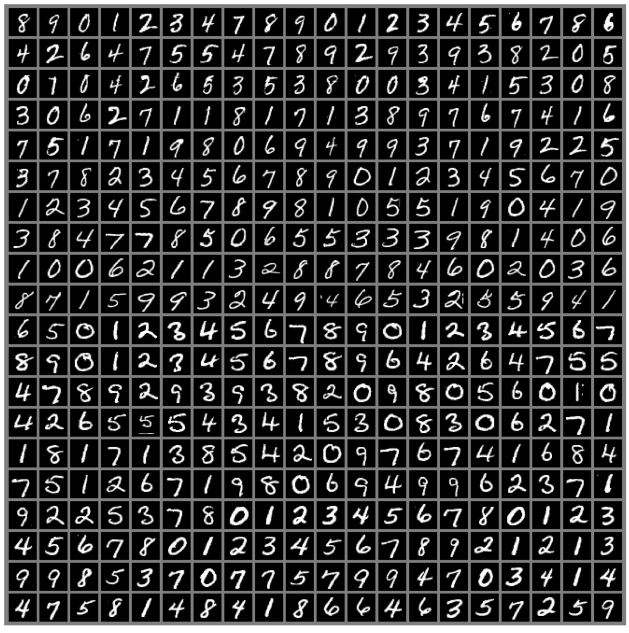
The MNIST Dataset
the drosophila of machine learning
Figure 1.9

Slide 37
Increasing Accuracy, and Real-World Impact
A dramatic moment in the meteoric rise of deep learning came when a convolutional network won ILSVRC challenge for the first time and by a wide margin, bringing down the state-of-the-art top-5 error rate from 26.1% to 15.3% (Krizhevsky et al., 2012),
Since then, these competitions are consistently won by deep convolutional nets
The introduction of deep learning to speech recognition resulted in a sudden drop of error rates, with some error rates cut in half.

Slide 38
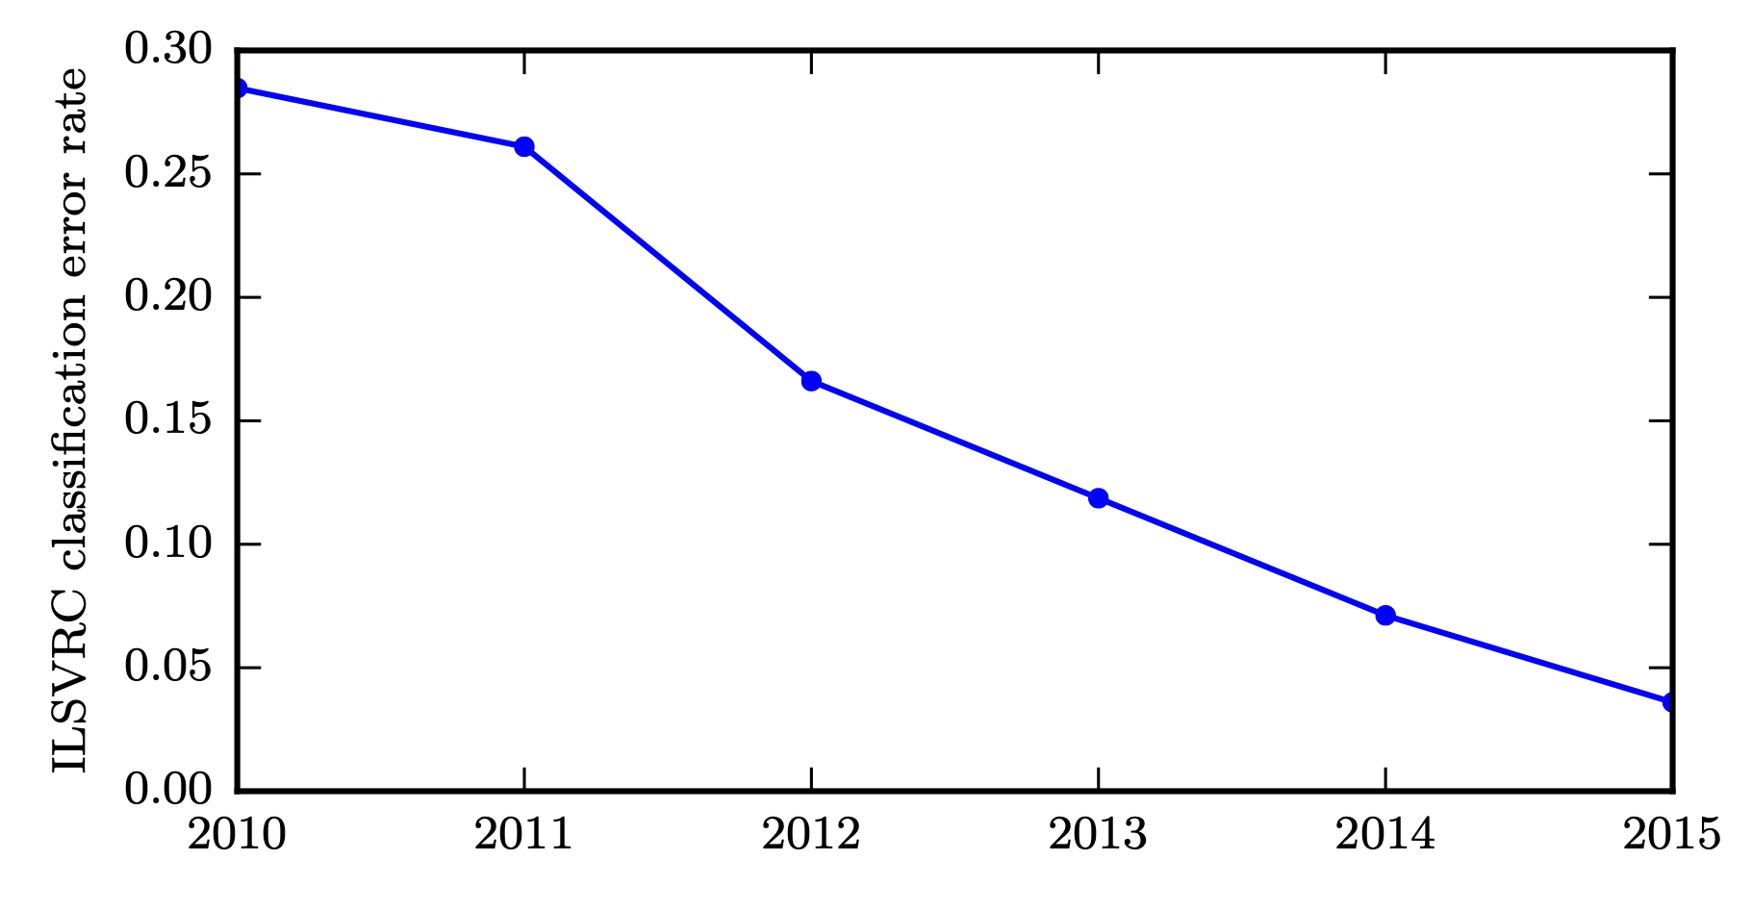
Solving Object Recognition
Figure 1.12
Notes:
The largest contest in object recognition is the ImageNet Large Scale Visual Recognition Challenge (ILSVRC) held each year

Slide 39
Increasing complexity
Deep networks have also had spectacular successes for pedestrian detection and image segmentation
and yielded superhuman performance in traffic sign classification
neural networks could learn to output an entire sequence of characters transcribed from an image, rather than just identifying a single object.

Slide 40
Other applications
Recurrent neural networks, such as the LSTM sequence model are now used to model relationships between sequences and other sequences rather than just fixed inputs.
In the context of reinforcement learning, an autonomous agent must learn to perform a task by trial and error, without any guidance from the human operator.
DeepMind demonstrated that a deep reinforcement learning system is capable of learning to play Atari video games, reaching human-level performance
Deep learning has also significantly improved the performance of reinforcement learning for robotics

Slide 41
Companies and tools
Google, Microsoft, Facebook, IBM, Baidu, Apple, Adobe, Netflix, NVIDIA and NEC.
Competition and Convergence of Deep Learning Libraries:
TensorFlow 2.0
PyTorch 1.3
Python 2 support ended on Jan 1, 2020.
>>> print “Goodbye World”

Slide 42
Turing award
Yann LeCun
Geoffrey Hinton
Yoshua Bengio
Turing Award given for:
“The conceptual and engineering breakthroughs that have made deep neural networks a critical component of computing.”
Notes:
https://deeplearning.mit.edu
2020

Slide 43
Online courses
Fast.ai: Practical Deep Learning for Coders
Jeremy Howard et al.
Stanford CS231n: Convolutional Neural Networks for Visual Recognition
Stanford CS224n: Natural Language Processing with Deep Learning
Deeplearning.ai (Coursera): Deep Learning
Andrew Ng
Reinforcement Learning
David Silver: Introduction to Reinforcement Learning
OpenAI: Spinning Up in Deep RL

Slide 44
Summary
Deep learning is an approach to machine learning that has drawn heavily on our knowledge of the human brain, statistics and applied math as it developed over the past several decades.
In recent years, it has seen tremendous growth in its popularity and usefulness, due in large part to more
powerful computers,
larger datasets and
techniques to train deeper networks.
The years ahead are full of challenges and opportunities to improve deep learning even further and bring it to new frontiers.

Slide 45
Watch
https://www.youtube.com/watch?v=vi7lACKOUao
https://www.youtube.com/watch?v=0VH1Lim8gL8

